Slide 1
Introduction to Object-Oriented Programming in Java using Greenfoot
Chapter 4:
Finishing the Crab Game
Material presented in these slides is based on content from the book Introduction to Programming with Greenfoot by Michael Kölling, 2nd edition ©2016 Pearson Higher Education (Upper Saddle River, NJ)

Slide 2
Review of Concepts from Ch. 3
When a method we wish to call is not in our own class or inherited from another, we need to specify the class or object that has the method before name, followed by a dot. This is called dot notation.
Methods that belong to classes (as opposed to objects) are marked with the keyword static in their signature header. They are also class methods.
A method definition defines a new action for objects of the class for which the method is defined. The action is not immediately executed, but the method call be called with a method call later to execute it.

Slide 3
Review of Concepts from Ch. 3 (continued)
Comments are written into the source code as explanations for human readers. They are ignored by the computer.
The API Documentation lists all classes and methods available in Greenfoot. We often need to look up methods there.

Slide 4
Adding objects automatically
Currently we place actors in the world manually. (A "real" game would have this happen automatically.)
However, one object does get instantiated automatically when we compile – care to guess what it is?
  Answer: The world itself is created!
    It is an instance of the CrabWorld class

Slide 5
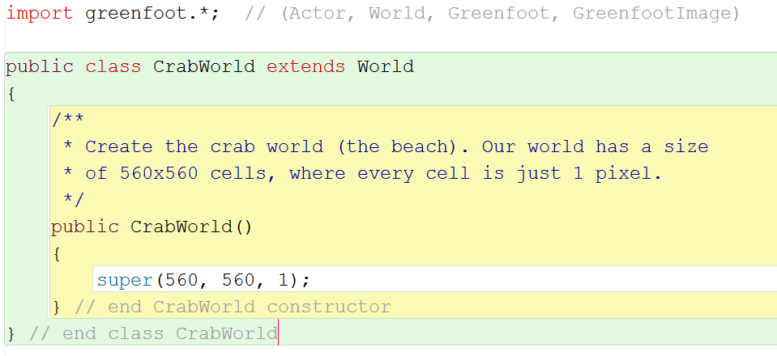
Let's look at the CrabWorld source code
Note: If you do not have your own crab game at this stage (whatever is equivalent to the completion of Ch. 3), you can use little-crab-4 as the book scenario for this chapter
This code segment is the constructor for this class.
Go ahead and label all closing braces with end-of-line comments!

Slide 6
Constructors
A constructor looks quite similar to a method, but there are some differences:
  A constructor has no return type specified between the keyword public and the constructor's name
  The name of the constructor is always the same as the name of the class
Concept: A constructor is a special kind of method that is always automatically executed whenever an instance of the class is created. It can then do what it wants to do to set up this new instance into a "starting state."

Slide 7
A closer look at the CrabWorld constructor
In our case, the CrabWorld constructor sets the world to the size we want (here, 560 by 560 cells) and also specifies the resolution (the number of pixels per cell, which here is equal to 1)
CrabWorld is a subclass of World, so we should look at the World class documentation (to see a generic version of the World constructor summary)
  Go to Help > Greenfoot Class Documentation
  Click on the World link in the left menu
  Scroll down to the Constructor Summary

Slide 8
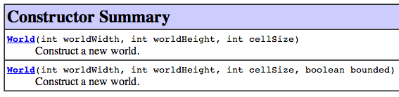

The World Constructor Summary
We can see the correspondence between the World constructor definition and the constructor in its CrabWorld subclass
Note: The keyword super tells Java that we are actually calling the corresponding constructor of the immediate parent class (World). What would be a good analogy to help you remember why this is needed?

Slide 9
A quick (but important) side note on overloading
In Java, constructors (and methods) can be overloaded, meaning that you can have multiple definitions of a constructor (or method) having the the same name, but different signatures [and yes, I mean signature this time]
We specify which version of the constructor is invoked by the specific parameter list that is used:
super(560, 560, 1); // calls the FIRST version
super(560, 560, 1, true); // calls the SECOND version
We will cover overloading in more detail later in the course (it is related to polymorphism, one of the key concepts in OOP)

Slide 10
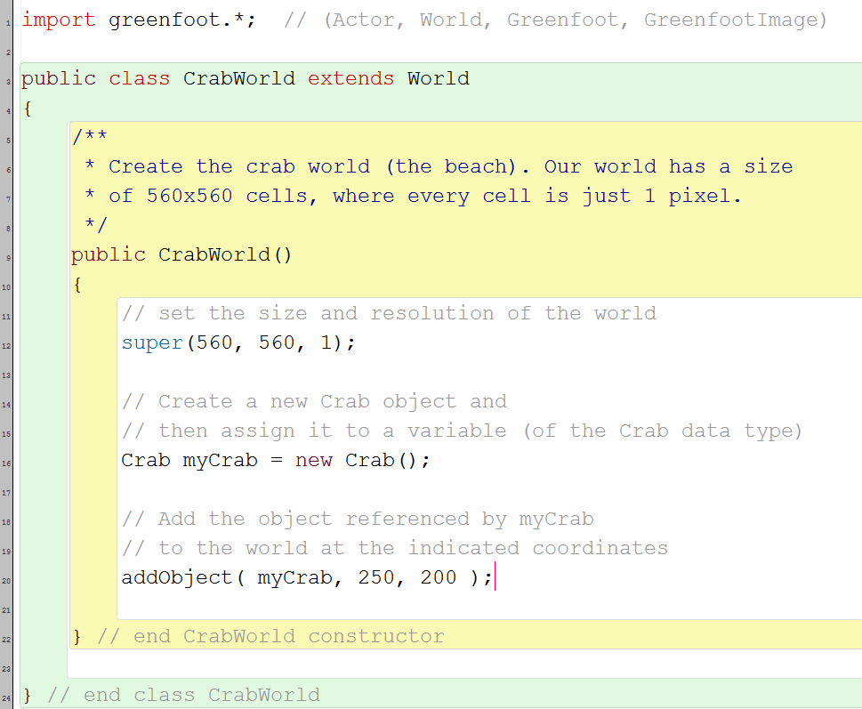
How to automatically create actors
Since the CrabWorld constructor is automatically executed when the CrabWorld object is instantiated, we can insert code for creating and and adding actor objects into the CrabWorld constructor—and that code will be automatically executed as well. For example:

Slide 11
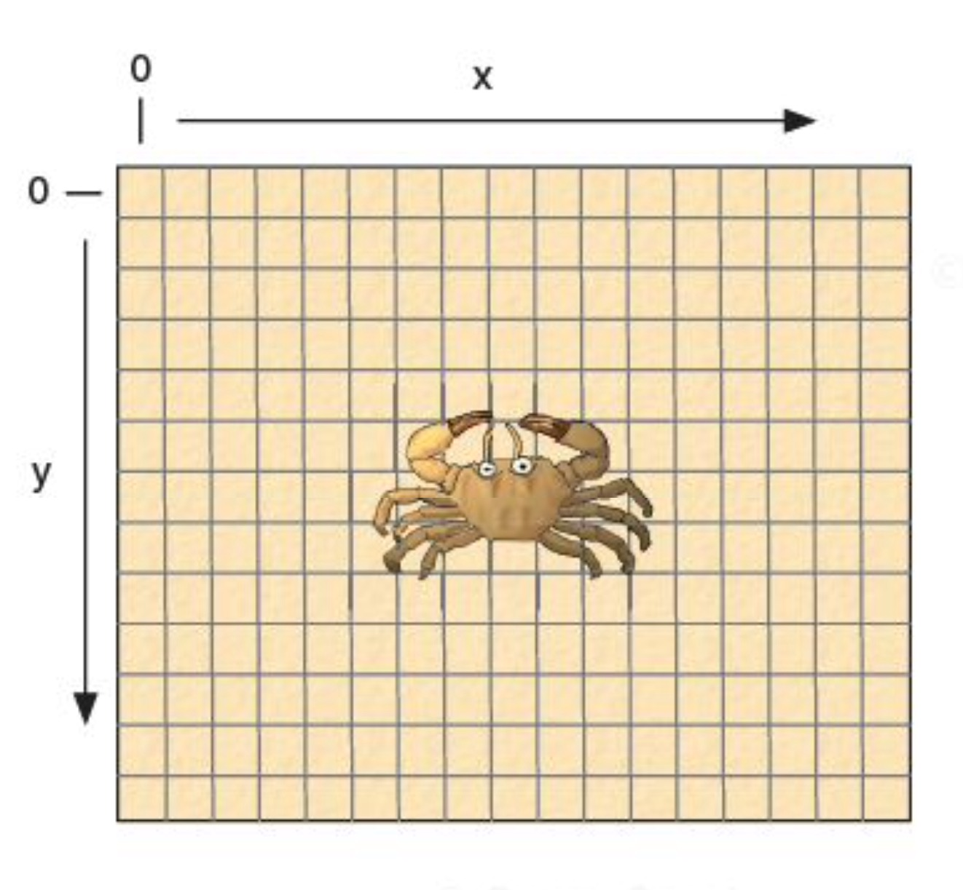
The coordinate system of the world
Note that the origin (0,0)is at the top left of the world
The location (250,200)is 250 cells from the left edge of the world, and 200 cells from the top edge

Slide 12
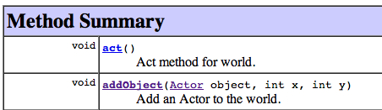
The addObject method
This is a method of the World class. We can look it up by looking at the class documentation for the World class.
Reading the method signature from left to right, we can determine the following:
  The method does not return a result (why not?)
  The name of the method (which is what?)
  The method has three parameters (what are they?)
  The types of each of the parameters (which are?)
The addObject method can be used to add a new actor into the world without having to "drag" the object into the world ourselves. Since the method belongs to the World class and CrabWorld is-a World (it inherits all of World's methods), then we can simply call addObject from within the CrabWorld class!

Slide 13
Concept: Java objects can be created programmatically (from within your code) by using the new keyword
While the addObject method allows us to add an actor object to the world, we must first have an object to add, right?
The Java keyword new allows us to create new objects of any of the existing classes. For example, the expression
creates a new instance of class Crab.
The expression to create new objects always starts with the keyword new, followed by the name of the class we wish to create, and a parameter list (which is empty in our example).
The parameter list allows us to pass parameters to the constructor. However, since we have not specified a constructor for our Crab class, the default parameter list is empty.
new Crab()

Slide 14
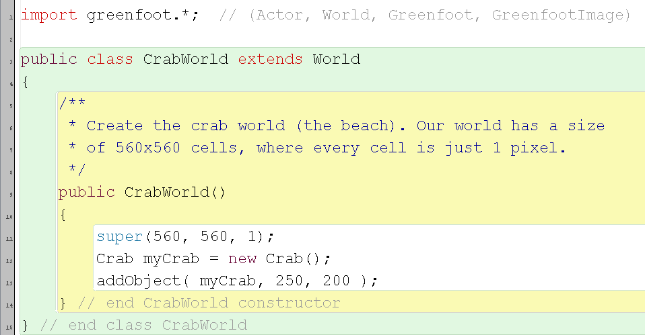
Using new with addObject to add a new actor to the world
We can now use myCrab (a reference to the Crab object) in place of the Actor object parameter of the addObject method to add this object to the world!
The remaining two parameters specify the x and y coordinates of the position where we wish to add the object

Slide 15
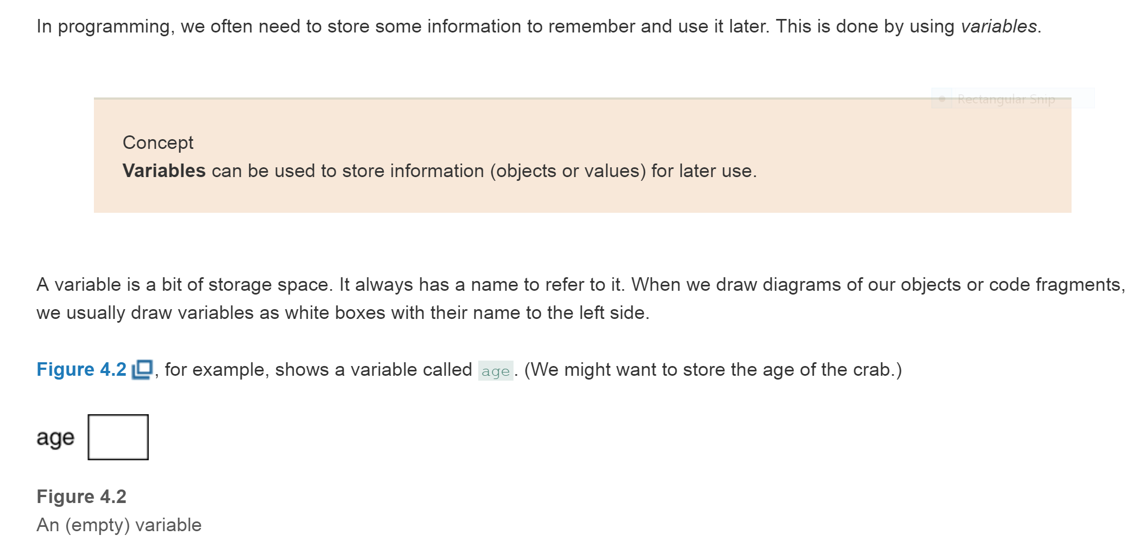
Variables

Slide 16
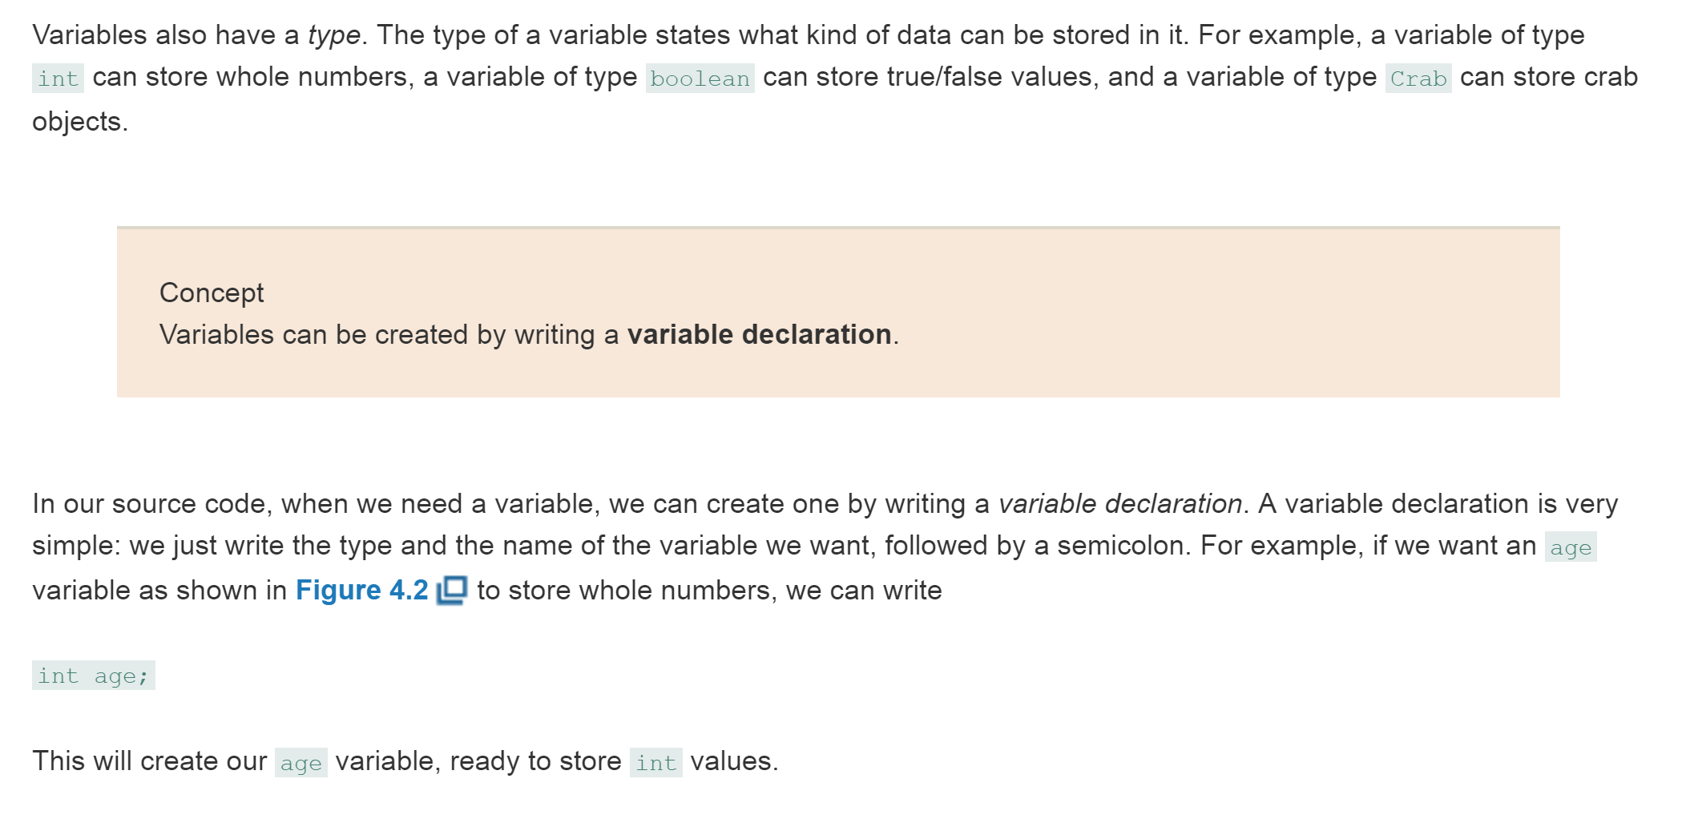
Variables, cont’d

Slide 17
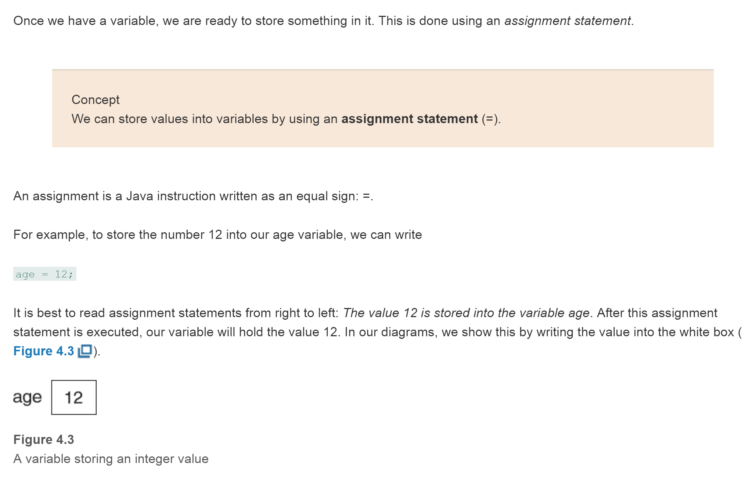
Assignment Statements

Slide 18
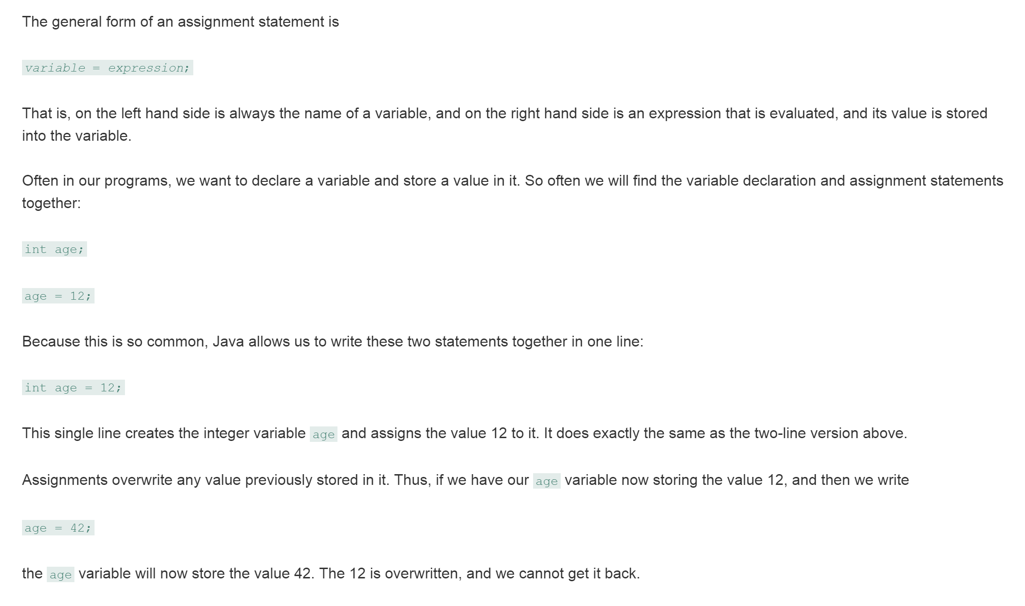
Assignment Statements, cont’d

Slide 19
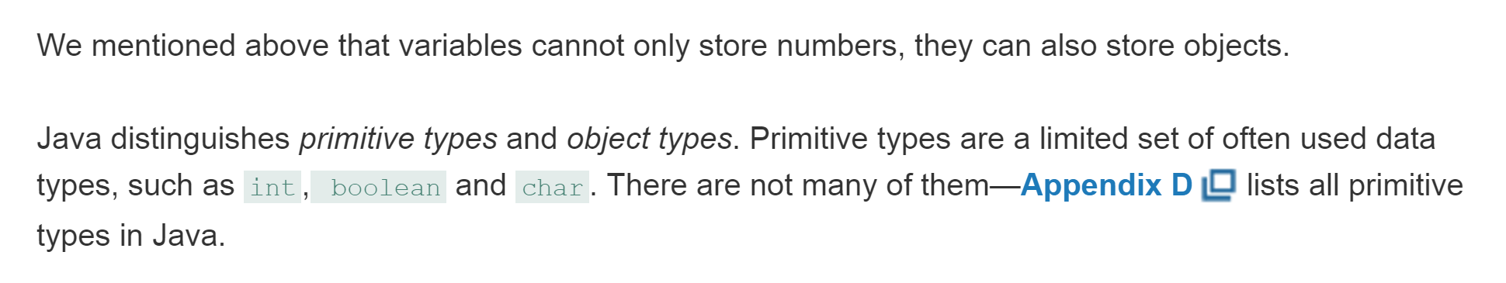
Object variables
This is not exactly correct; variables do not store the objects themselves; they only store references to objects
Concept: Variables of primitive types store numbers (int), logical (boolean) values, and characters (char), while variables of object types (also known as reference types) store references to objects.

Slide 20
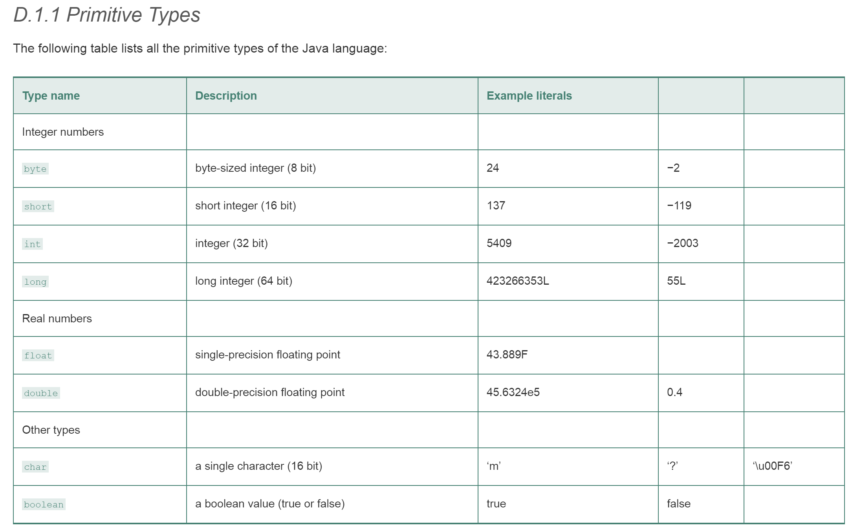
From Appendix D
byte
short
int
long
float
double
char
boolean

Slide 21
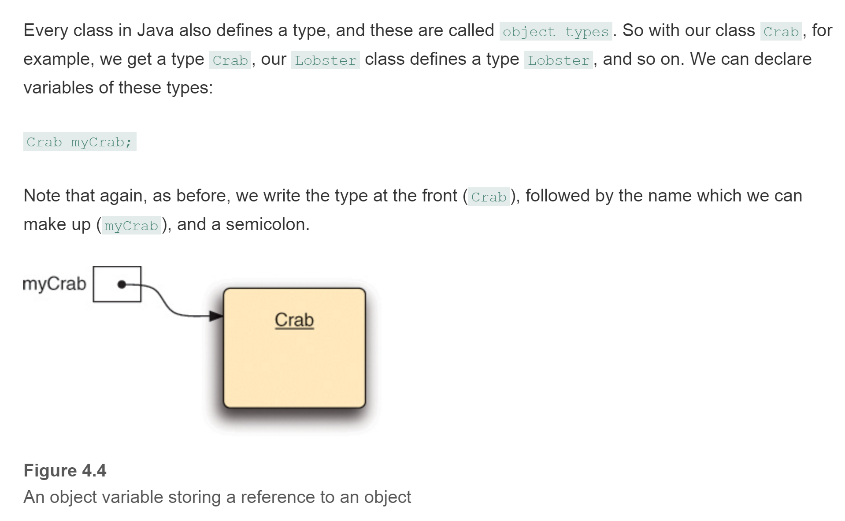
Object variables, cont’d
The variable myCrab stores a pointer (or as it’s more commonly termed in Java, a reference) to an object in memory; myCrab does not store the object itself!

Slide 22
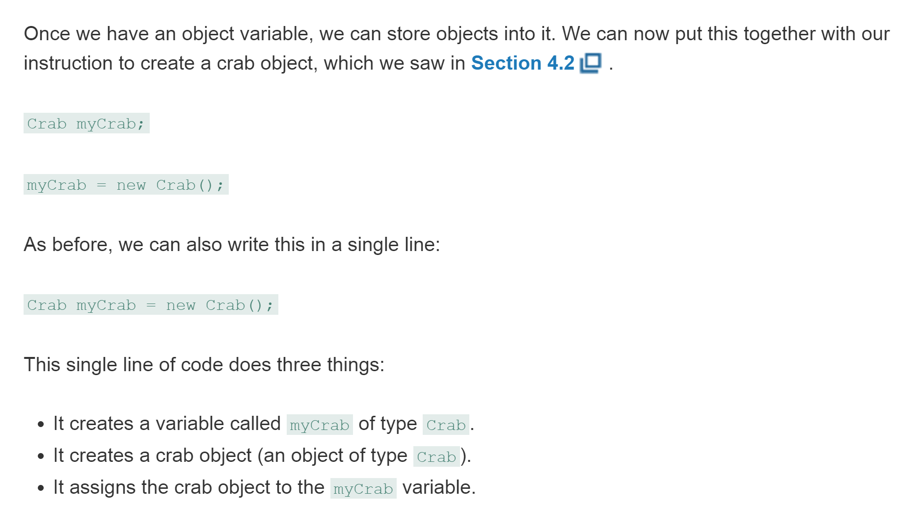
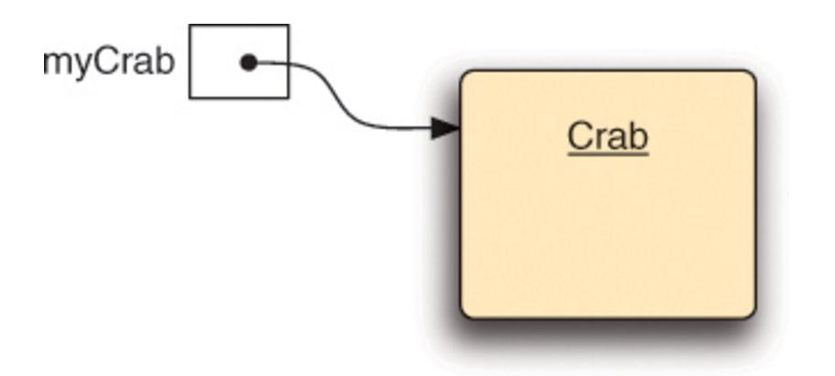
Object variables, cont’d
It assigns a reference to the crab object to the myCrab variable

Slide 23
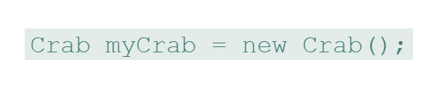
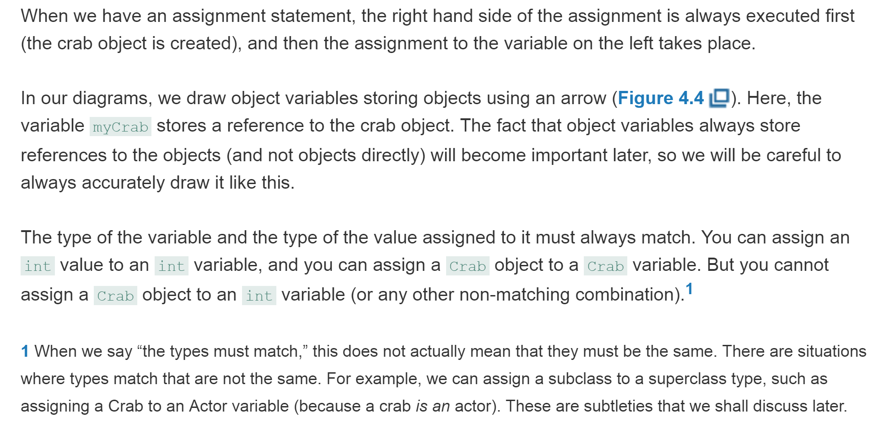
Concept: Objects are “stored” in variables by storing a reference to the object.

Slide 24
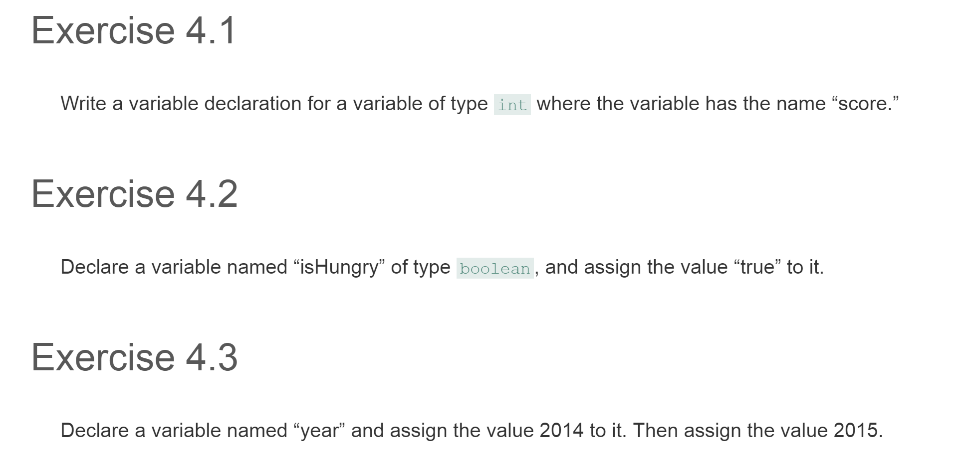

Slide 25
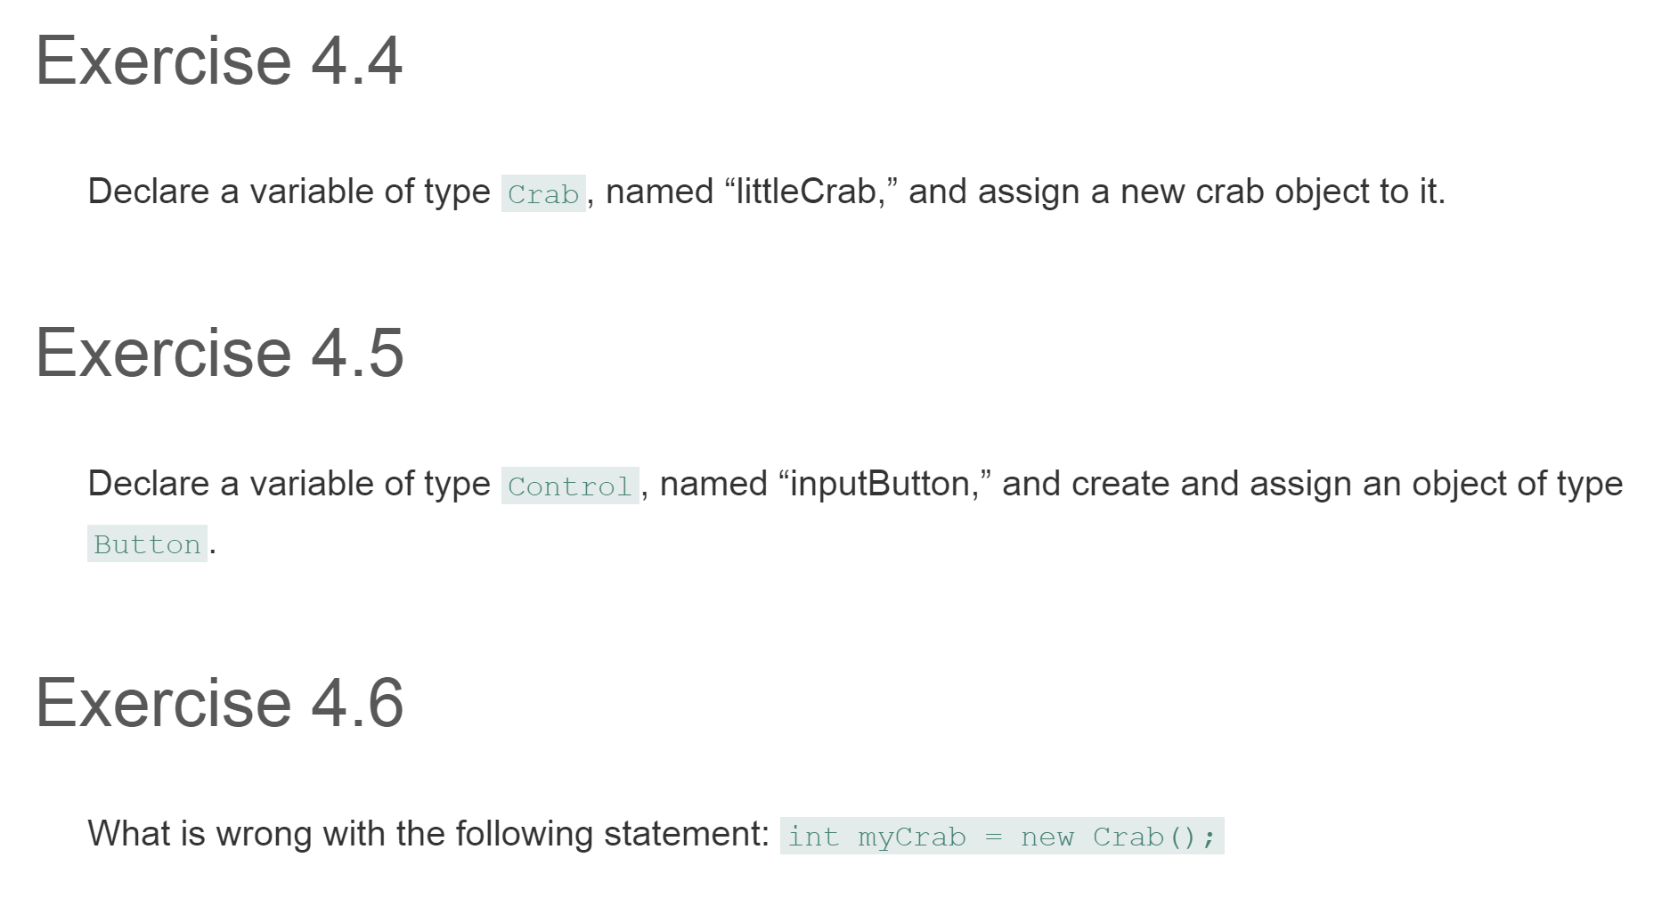

Slide 26
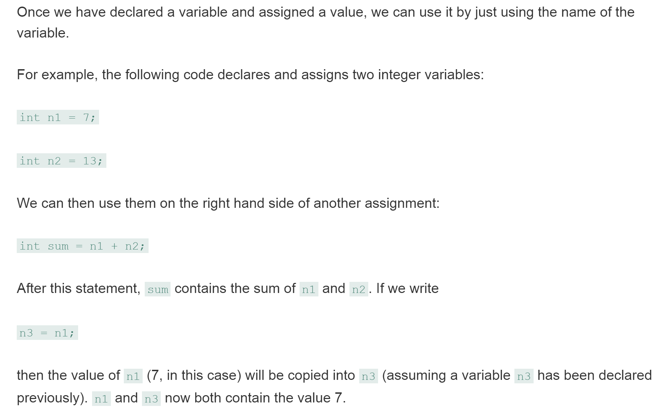
Using Variables

Slide 27
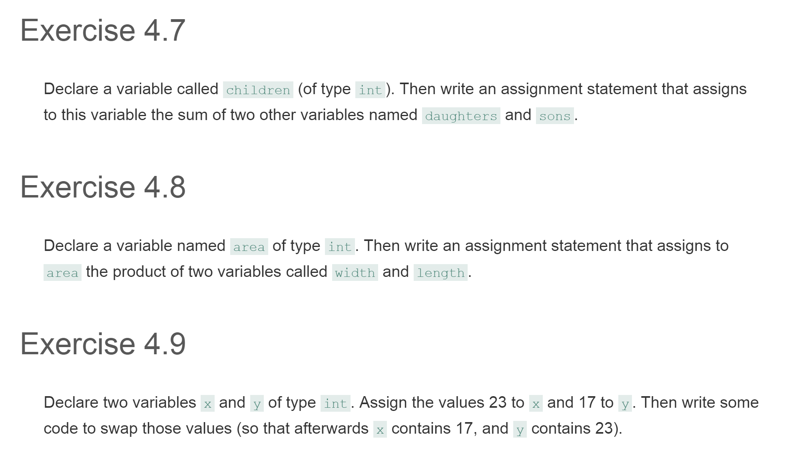

Slide 28
Exercises!
4.10 – Add code to the CrabWorld constructor of your own project to create a crab automatically, as discussed
4.11 – Add code to automatically create three lobsters in the CrabWorld . You can choose arbitrary locations for them in the world — just set whatever x,y coordinates you desire.
4.12 – Add code to create two worms at arbitrary locations in the CrabWorld .

Slide 29
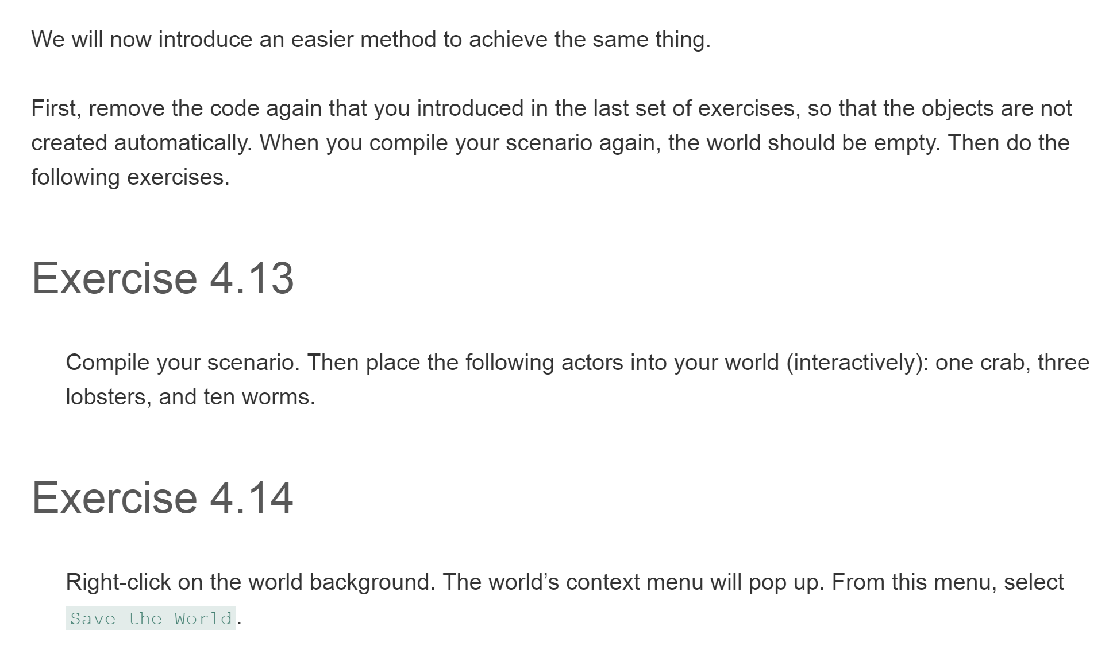
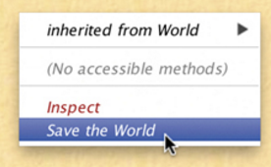
Save the World

Slide 30
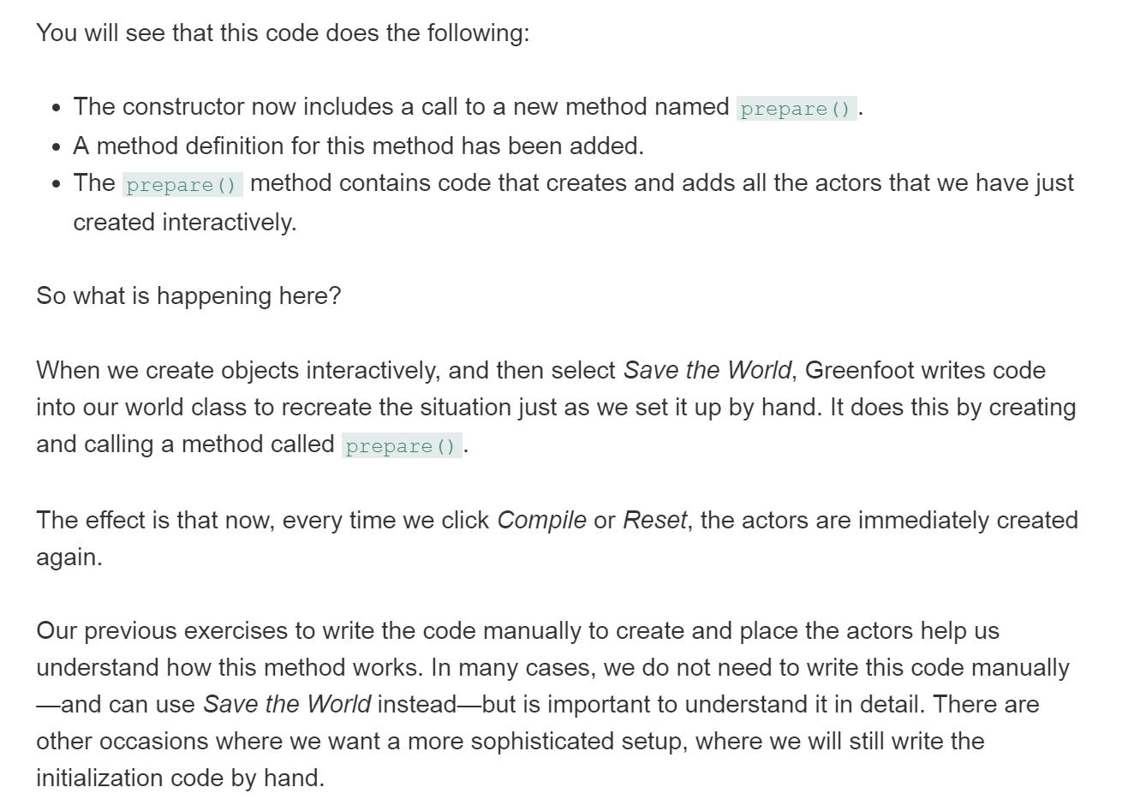
Save the World, cont’d

Slide 31
A slightly more challenging exercise
(not in your book!)
In the CrabWorld class, modify the prepare() method to use random numbers for the coordinates of each of the 10 worms. You can do this by replacing your coordinate values will calls to get random numbers from the Greenfoot class.
  Before you start writing any code, first determine what range of possible random values should be generated, and then come up with an appropriate expression that will generate a random integer in that range.

Slide 32
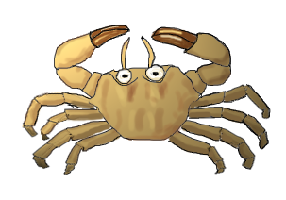
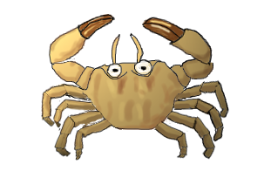
Animating images
Let's improve the appearance of the crab's movement using animation, so that it appears to move its legs while it is walking
Animation is achieved with a simple trick:
  We have two images of the crab (crab.png and crab2.png), and we simply switch the crab's images between these two versions fairly quickly
In order to accomplish this, we have to use some more variables and also discuss how to work with Greenfoot images.
crab.png
(legs out)
crab2.png
(legs in)

Slide 33
Concept: Greenfoot actors maintain their visible image by holding [a reference to] an object of type GreenfootImage
GreenfootImage helps in using and manipulating images.
We can obtain an image by instantiating (and constructing) a new GreenfootImage object—using Java's new keyword—with the filename of the image file as a parameter to the constructor. For example, to get access to the crab2.png image, we can write:
All Greenfoot actors have images. By default, actors get their image from their class. We assign an image to the class when we create it, and every object created from that class will receive, upon creation, a copy of that same image.
Note that the file we name here must exist in the scenario's images folder.
new GreenfootImage("crab2.png")
This does not mean, however, that all objects of the same class must always keep the same image. Every individual actor can decide to change its image at anytime.

Slide 34

Quick exercise
4.15 – Check the documentation of the Actor class. There are two methods that allow us to change an actor's image. What are they called, and what are their parameters? What do they return?
This is the version of the setImage method that we shall use.
Notes:
Why are we using the first version and not the second? Because we wish to separate the creation of the image object and the setting of the image—we want to be able to switch the image back and forth while the crab is walking. Therefore, we want to set the image many times, but we only need to create each image once.

Slide 35
Using the setImage method (with the GreenfootImage parameter) to update the crab's image
Here is a code snippet that we can use:
Note that the above line of code does two things:
  We call the setImage method, which expects an image as a parameter:
  And in place of some-image we write
This creates the image object from the named image file crab2.png.
setImage( new GreenfootImage("crab2.png") );
setImage( some-image );
new GreenfootImage("crab2.png")
When the whole line is executed, the inner part of the code—the creation of the GreenfootImage object—is executed first. Following that, the outer part of the code— the setImage method call—is executed, and the image object we just created is passed as a parameter.
For our purposes here, it is better to separate the creation of the image object and the setting of the image. Since we will be switching the crab's image back and forth repeatedly while it is walking, it makes more sense to create each image only once, and then set the image as often as needed.

Slide 36
Concept: Instance variable (also called fields ) can be used to store information (objects object references or values) for later use . They are variables that belong to an object (rather than to a method).
To store the two images in our crab object, we need a new construct that we have not used before: a variable
  All programming languages use variables to store information
Java supports different kinds of variables. The ones we have seen before are called local variables. Here, we will look at instance variables, also called fields.
An instance variable is a bit of memory that belongs to the object (which is an instance of the class, hence the name "instance variable").
Each object in the class will have a separate copy of the instance variable, and this copy "lives" in memory for the “lifetime” of the object.

Slide 37
Local variables and instance variables behave differently, especially regarding their lifetime.
Concept: Lifetime of instance variables: Instance variables persist as long as the object exists that holds them.
Concept: Lifetime of local variables: Local variables persist only during execution .
Local variables belong to the method in which they are declared, and disappear as soon as the method finishes executing.
  Every time we call the method, the variables are created again, and can be used while the method executes, but they do not survive between method calls. When the method execution ends, the values or object references stored in them are lost.
  (To be exact, local variables belong to the scope they are declared in. This could be the scope of a method, or it could be the scope of a different block of code, such as an if-statement.)
Instance variables, on the other hand, belong to the object they are declared in, and they survive as long as the object exists. They can be used over and over again, over multiple method calls, and can be used by multiple methods.
  Thus, if we want an object to store information for a longer time, an instance variable is what we should use.

Slide 38
Declaring an instance variable
An instance variable is declared in a class by writing the keyword private followed by the type of variable and then the variable name:
The type of the variable defines what we want to store in it. (In the present example, the type will be GreenfootImage.)
The variable name allows us to refer to this variable elsewhere in the code, and it should describe what this variable is used for.
Let's look at our Crab class as an example…
private variable-type variable-name;

Slide 39
The Crab class with two instance variables
import greenfoot.*; // (Actor, World, Greenfoot, GreenfootImage)
// comment omitted
public class Crab extends Actor
{
private GreenfootImage image1;
private GreenfootImage image2;
// method definitions...
} // end class Crab
Here, we have declared two variables in our Crab class. Both are of type GreenfootImage, and they are named image1 and image2 .
Also, we will always write instance variable declarations at the top of the class, before all constructors and methods. Java does not enforce this, but it is a good practice so that we can always find variable declarations easily when we need to see them.

Slide 40
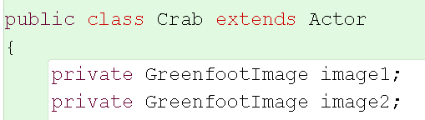
Exercises
4.16 – Before adding any code, right-click a crab object in your world and select Inspect from the crab object's popup menu
4.17 – Why do you think the crab has any variables at all, even though we have not yet declared any in our Crab class?
4.18 – Add the variable declarations shown below to your version of the Crab class. Make sure that the class compiles.
4.19 – After adding the variables, Inspect your crab object again. Take a note of the variables and their values (shown in the white boxes)

Slide 41
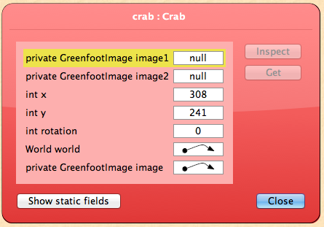
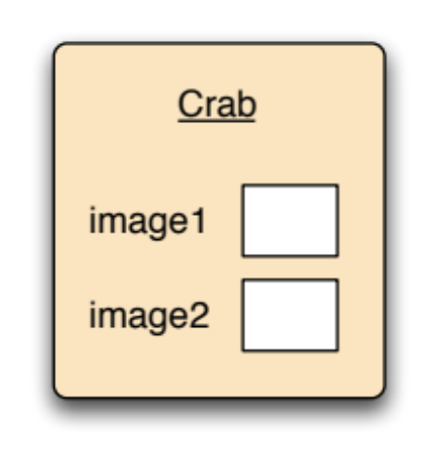
Remember, variable declaration is not the same thing as variable assignment
Note that the declaration of these two GreenfootImage variables (image1 and image2) does not give us two GreenfootImage objects!
All it does is give us (allocate) some ”empty space" (memory) in which to store [references to] two objects!

Slide 42
Variable declaration is not the same thing as variable assignment (cont'd)
Next, we actually have to create the two image objects and store them into the variables. The way we create the objects was already seen earlier:
To store the [a reference to]object into the variable, we need a Java construct known as an assignment.
An assignment is a statement that enables us to store something (an object or value) into a variable:
new GreenfootImage("crab2.png")
Variable = expression;

Slide 43
Concept: An assignment statement assigns an object an object reference or a value to a variable
An assignment statement is written using a single equals sigin:
In our crab example, we will write:
These two lines of code will create the two images we wish to use and store (references to)them into the variables image1 and image2.
On the left of the equals sign is the name of the variable that we will use for storage…
…on the right of the equals sign is the object reference or value (of the expression) that we want to store in the variable on the left
variable = expression;
The equals sign is also called the assignment symbol. Sometimes we may read it as "becomes", as in "variable becomes (the value of the) expression"
image1 = new GreenfootImage("crab.png");
image2 = new GreenfootImage("crab2.png");

Slide 44
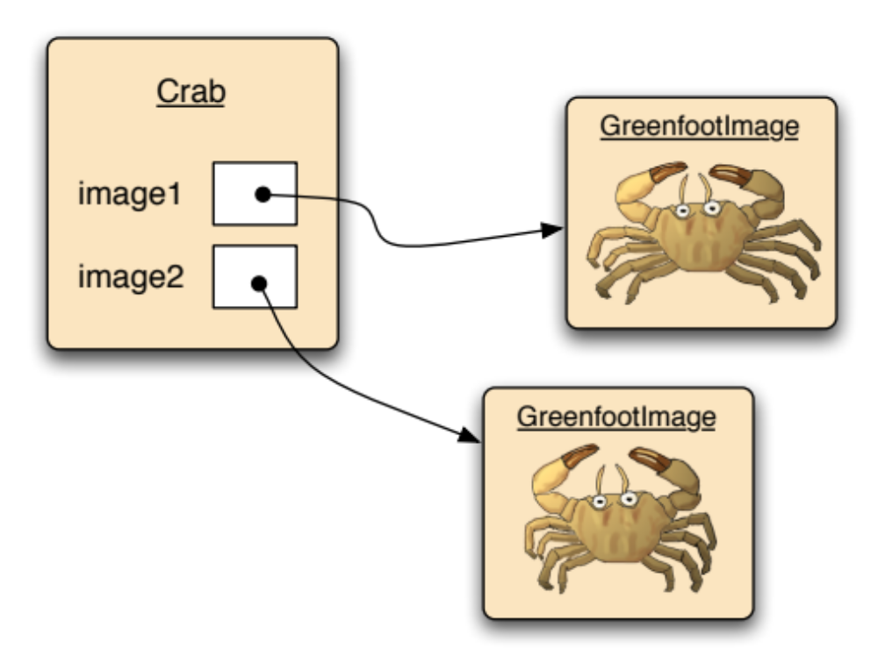
We will then have three objects (one crab, two images), and the crab's variables will contain references to those images
Concept: When an object is assigned to a variable, the variable contains a reference to that object.

Slide 45
Using actor constructors
So where do we actually put the code for creating the images and storing them in their corresponding variables?
Since this should only be done once (when the object is created), and NOT EVERY TIME we call the Crab's act method, we cannot put this code inside the Crab's act method. Instead, we will put this code inside a constructor for the crab.
Just as we used the constructor of the world to initialize the world, we can use a constructor of an actor class to initialize the actor.
The code in the constructor is executed once , when the actor object is created .
  But remember that the act method is executed repeatedly

Slide 46
Initializing the variables in the Crab constructor
The same rules described for the World constructor apply to the Crab constructor:
The signature of a constructor does not include a return type
The name of the constructor is the same as the name of the class
The constructor is automatically executed when a crab object is created (and where/when does this happen?)
import greenfoot.*; // (Actor, World, Greenfoot, GreenfootImage)
// JavaDoc comment omitted
public class Crab extends Actor
{
private GreenfootImage image1;
private GreenfootImage image2;
/**
* Create a crab and initialize its two images
*/
public Crab()
{
image1 = new GreenfootImage("crab.png");
image2 = new GreenfootImage("crab2.png");
setImage(image1);
} // end Crab constructor
// methods omitted
} // end class Crab
This last line of the constructor sets the first of the two created images as the crab’s curremt image. We can later use a similar method call to swap the images in the act method. This also demonstrates how the name of the variable (image1) can now be used to refer to the image object stored in it (important!!)

Slide 47
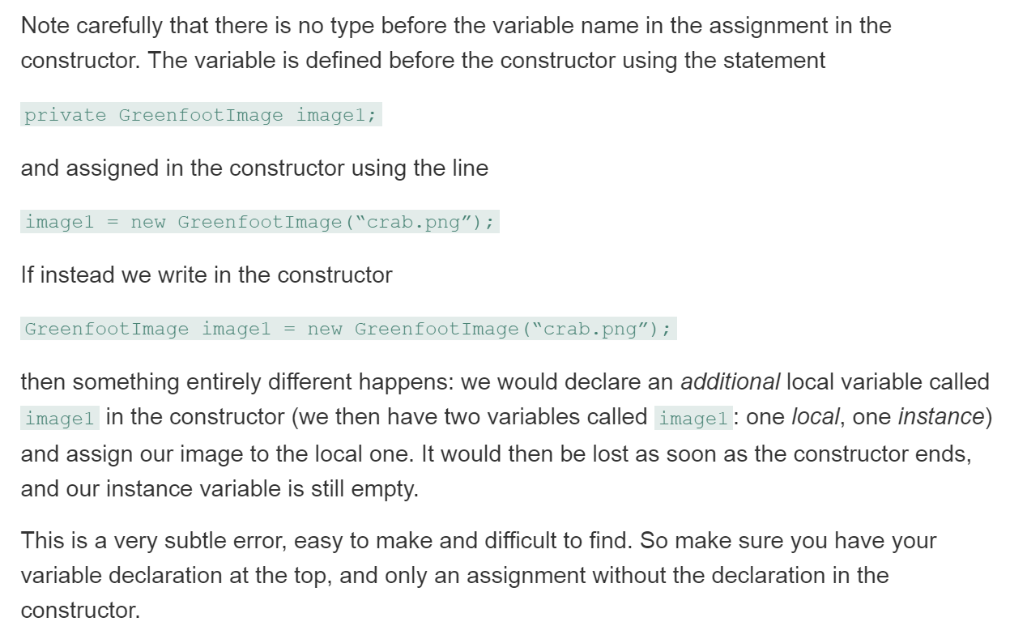
A possible pitfall for people new to Java programming

Slide 48
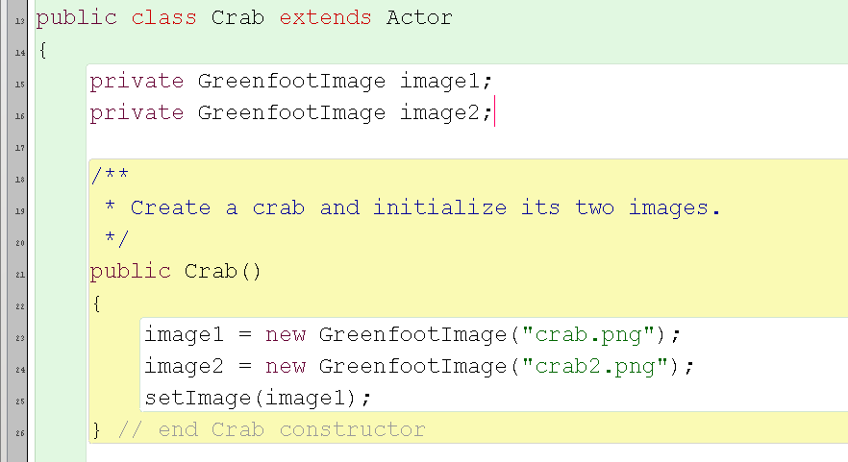
Exercises
4.20 – Add this constructor to your Crab class. You will not yet see any change in the behavior of the crab, but the class should compile, and you should be able to create crabs. Don't forget to add a JavaDoc comment before you compile.
4.21 – Inspect your crab object again. Take note of the variables and their values. Compare those to the notes you took previously. What's different?

Slide 49
Alternating the images
To actually animate the crab, we need to alternate(switch) between image1 and image2
In other words, at each execution step, if we are current showing image1, we now want to show image2 (and vice versa)
Here is some pseudo-code to express this:
if (our current image is image1) then
use image2 now
Else (otherwise):
use image1 now
Pseudo-code, as used here, is a technique expressing a task in a structure that resembles a cross between source code and plain English. It is intended for reading by humans, not machines, and so it often helps in working out how to write our real Java code.

Slide 50
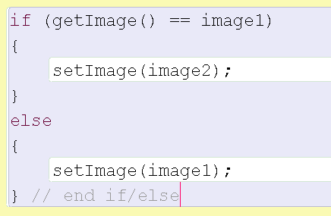
The "real" Java code for image switching
In this code segment, we notice several new elements:
The method getImage can be used to receive the actor's current image
The equality operator == (two consecutive equals signs) can be used to compare one value with another. Like other expressions that use relational operators, the result is either true or false.
The if statement has an extended form that we have not seen before. This form has an *else keyword after the first body of the if statement, followed by another block of statements.
Concept: We can test whether two things are equal by using a double equals symbol (==).
Pitfall! It is a common mistake to get the assignment operator (=) and the equality operator (==) mixed up!
Know when to use each!

Slide 51
The if/else statement in more detail
Concept: The if/else statement will execute *one segment of code when a given condition is true, and it will execute a different segment of code when that same condition is false.

Slide 52
Exercises
4.22 – Add the image switching code to the act method of your own Crab class. Try it out. (If you get an error, fix it—this should work.) Also try clicking the Act button instead of the Run button; this will allow you to observe the behavior more closely.
4.23 – In Chapter 3, we discussed using separate methods for subtasks, rather than writing more code directly into the act method. Do this with the image switching code: Create a new method called switchImage, move your image switching code to it, and call this method from within your act method.
4.24 – Call the switchImage method interactively from the crab's popup menu. Does it work?

Slide 53
Counting worms
To provide a way to "win" the game, let's add functionality so that the crab counts the *number of worm it has eaten
  If it has eaten eight worms, you "win" the game
  And we will play a short "winning sound" (a fanfare) when this happens

Slide 54
Additional code needed:
An instance variable to store the current count of worms eaten;
An assignment that initializes this variable to zero (0) at the beginning;
Code to increment our count each time we eat a worm;
Code that checks whether we have eaten eight worms, and if so, stops the game and plays the sound

Slide 55
Let's do one thing at a time…
What shall we name our new instance variable for storing the current count of worms eaten, how do we define it, and where in the code do we include this definition?
private int wormsEaten;
The keyword private is used at the beginning of all our instance variable definitions.
The type int indicates that we want to store integers in this variable
The name wormsEaten indicates what we intend to use the variable for (note that it follows the usual Java naming convention)
Finally, we will include this line of code at the beginning of the Crab class source code, along with the instance variables introduced earlier

Slide 56
Initialize the instance variable
We will add the following line to the end of the Crab constructor:
Doing so initializes the wormsEaten variable to zero when the crab is created
  Technically, this is redundant, because instance variables of type int are initialized to zero automatically
  However, sometimes we will want to initialize certain variables to be something other than zero, so it's good programming practice to always write an initialization statement
wormsEaten = 0;

Slide 57
Maintain a running count of worms that have been eaten
What code might we use to accomplish this?
But where should we put this line of code?
  Inside the lookForWorm method definition, after we have eaten a worm
wormsEaten = wormsEaten + 1;
This is an assignment statement: we first evaluate the right-hand side of the statement (add 1 to the current value of wormsEaten), and the resulting value of that expression is then assigned to the wormsEaten variable.
As a heads up for later on (CSCI 146): in algorithm pseudocode we might write this as
wormsEaten ← wormsEaten + 1;

Slide 58

And finally, we need to check for 8 worms eaten, and if so, then stop the game
What kind of statement do we use for this?
  We can accomplish this with one if statement:
  And where should we put this code segment?
    Right after wormsEaten = wormsEaten + 1;
Remember to use the double equals sign (==) for the "is equal to" relational operator
This sound file should already be in your scenario's sounds folder

Slide 59
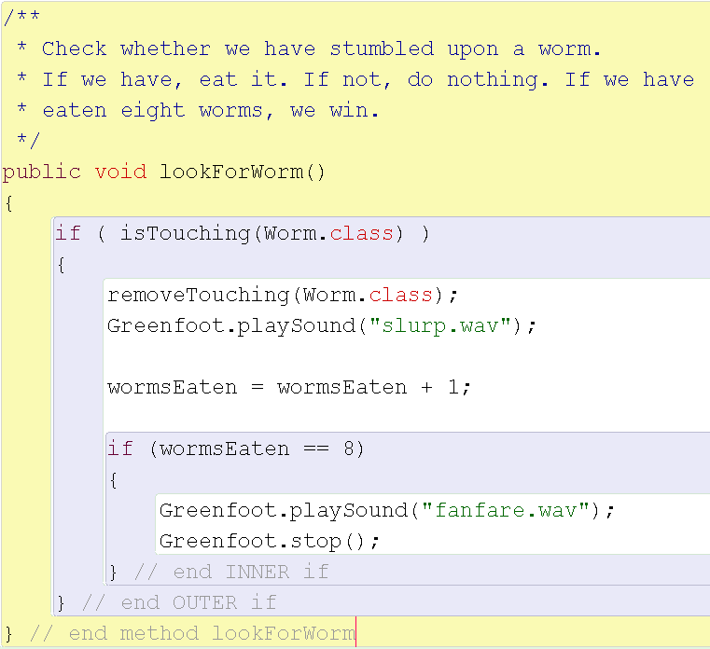
The complete lookForWorm method
(but don't forget to declare and initialize the wormsEaten instance variable, which doesn't happen here!)
Exercises (one more on next page)
4.25. Add all of the new code discussed (including the wormsEaten declaration and initialization to zero; not shown here) to your own scenario. Test it and make sure it works.
4.26. As a further test, open an object inspector for your crab object (by selecting Inspect from the crab object's popup menu) before you start playing the game. Leave the inspector open and keep an eye on the wormsEaten variable as you play.

Slide 60
One more exercise
4.27. The crab image changes fairly quickly when the crab runs, which makes the crab look a little "hyperactive." It might look "nicer" if the crab image changed on every second or third cycle through the act method. Try to implement this.
  To do this, you could add another counter variable (like wormsEaten, but obviously using a different name) that gets incremented in the act method. Every time it reaches 2 (or 3, or whatever your preference is), the image changes, and the counter will be reset to zero.

Slide 61
Summary of programming concepts
We have seen:
  How constructor can be used to initialize objects
    Constructors are always executed when a new object is created
    Side note: instructor are NOT inherited
  How to use instance variables (also called fields) to keep tract of an objects data
  How to use assignment statements to store information (and how to access that information later)
  How to use the new statement to programmatically create new objects
  The full version of the if statement, which includes an else clause part that is executed when the condition tested in the if-statement is not true
With all these techniques together, we can now write quite a good amount of code already!

